Slide 1


KONGU ENGINEERING COLLEGE
Adjustable kitchen sink
Team Members :
JAVIN N T,20EER038, 2 YEAR
ABIRAMI K P,20EER002, 2 YEAR
KAMALESH S,20EER044, 2 YEAR

Slide 2
Adjustable kitchen sink
Adjustable sink with motor and sensors
Solution Title
Theme
INTRODUCTION :
The inbuilt height of the kitchen sink in many homes is actually a very big problem that exist among us.
The sink is fixed at the suitable position, people with different heights are not comfortable with it
Many people are facing some of the health issues like back pain, due to this problem.

Slide 3
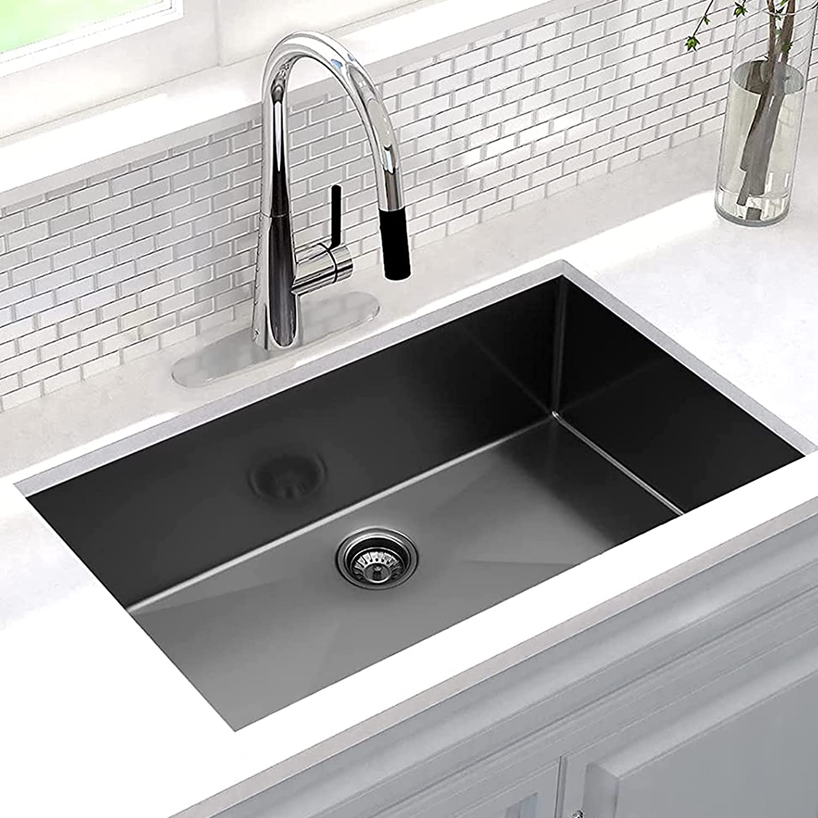
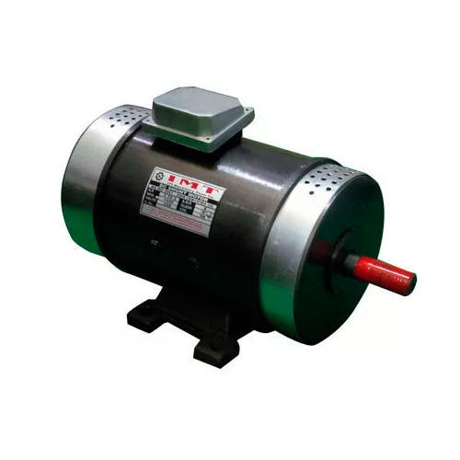
ABSTRACT:
The main objective of this project is to design an adjustable kitchen sink with the help of motor and sensors.
DC Motor is used to compress and elongate the kitchen sink which is generally made of a stainless-steel material.

Slide 4
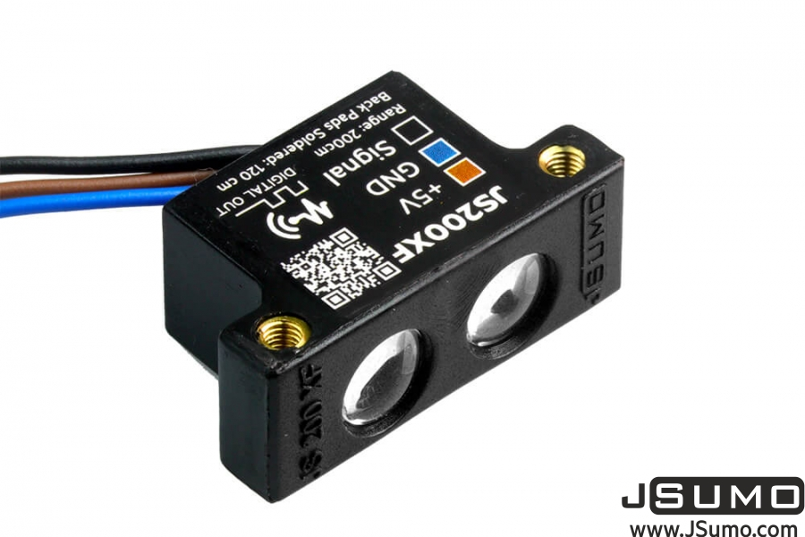

Infrared Sensors(IR) detects the height of the user whose range is about 3-15 feet or 1-5 meters and the information is given to the motor.
Then the DC motor moves the sink according to the information given from the IR sensor automatically.
The outlet of the sink is designed in such a way that it is an expandable and flexible one. And so, the kitchen sink can be adjusted according to the desire of the user which really helps the user a lot.
The Inlet pipe is also long and adjustable.

Slide 5
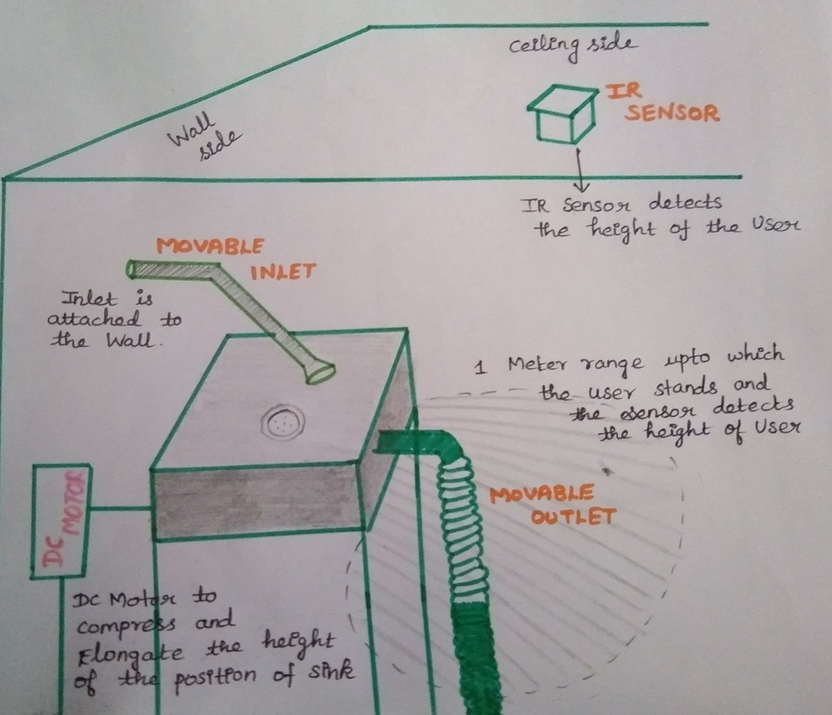
PICTORIAL REPRESENTATION:

Slide 6
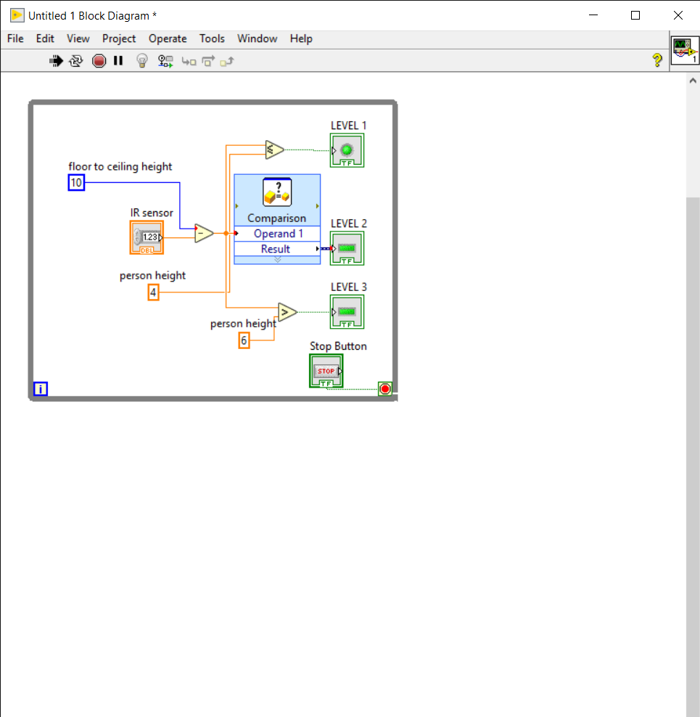
SIMULATION CIRCUIT DIAGRAM:

Slide 7
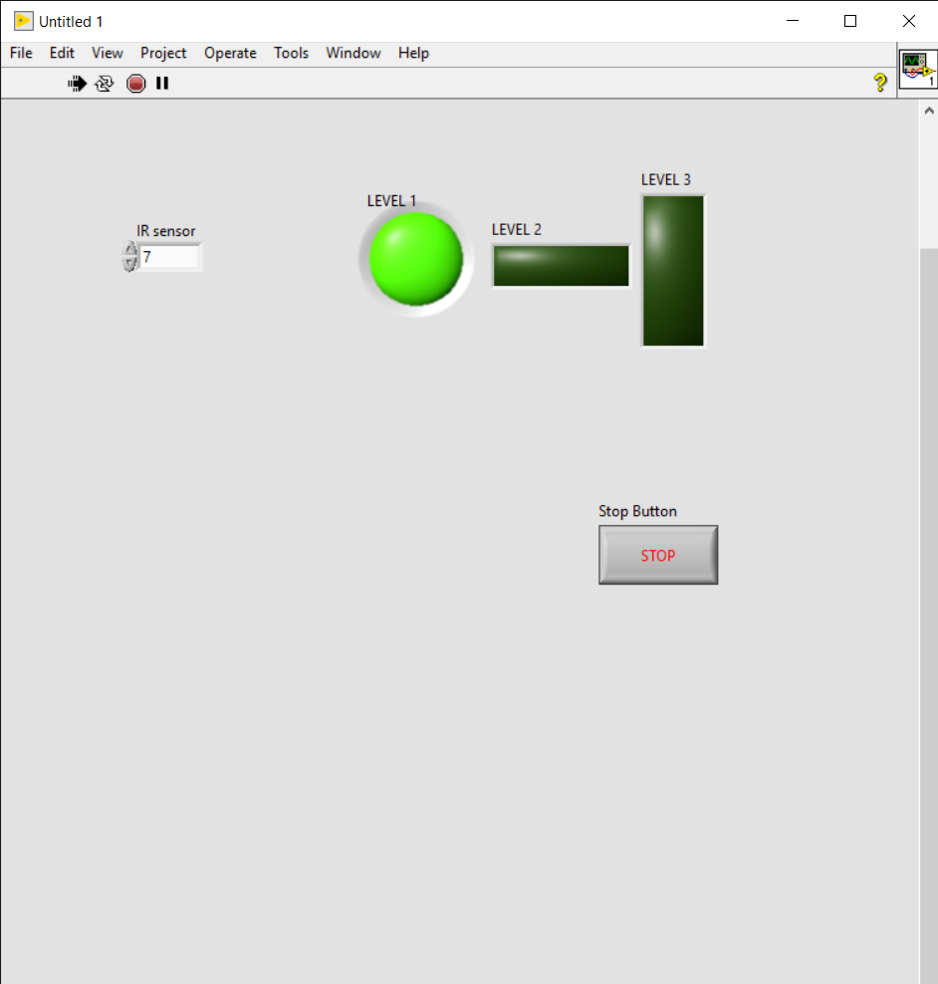
LEVEL 1:
If a person whose height is in a range of about 5 and above feet ,the circle shape will glow

Slide 8
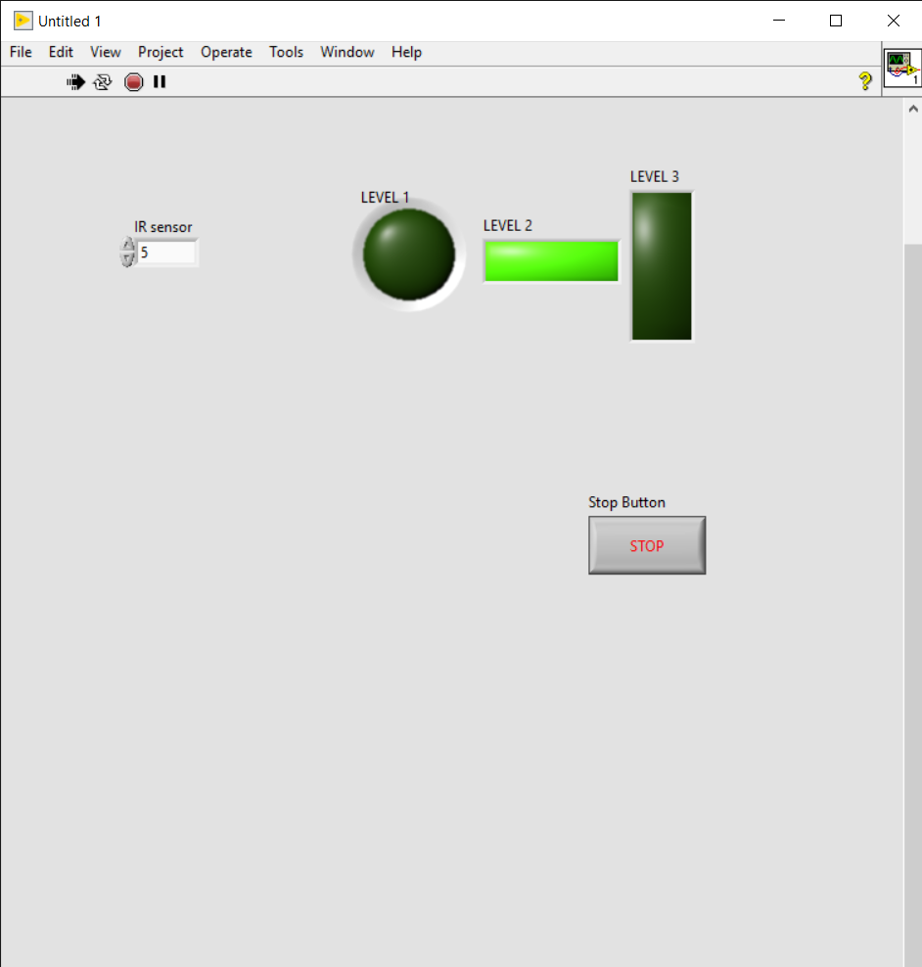
LEVEL 2:
Else if, a person whose height is in a range of about (3-5) feet, the vertically mounted rectangular shape will glow

Slide 9
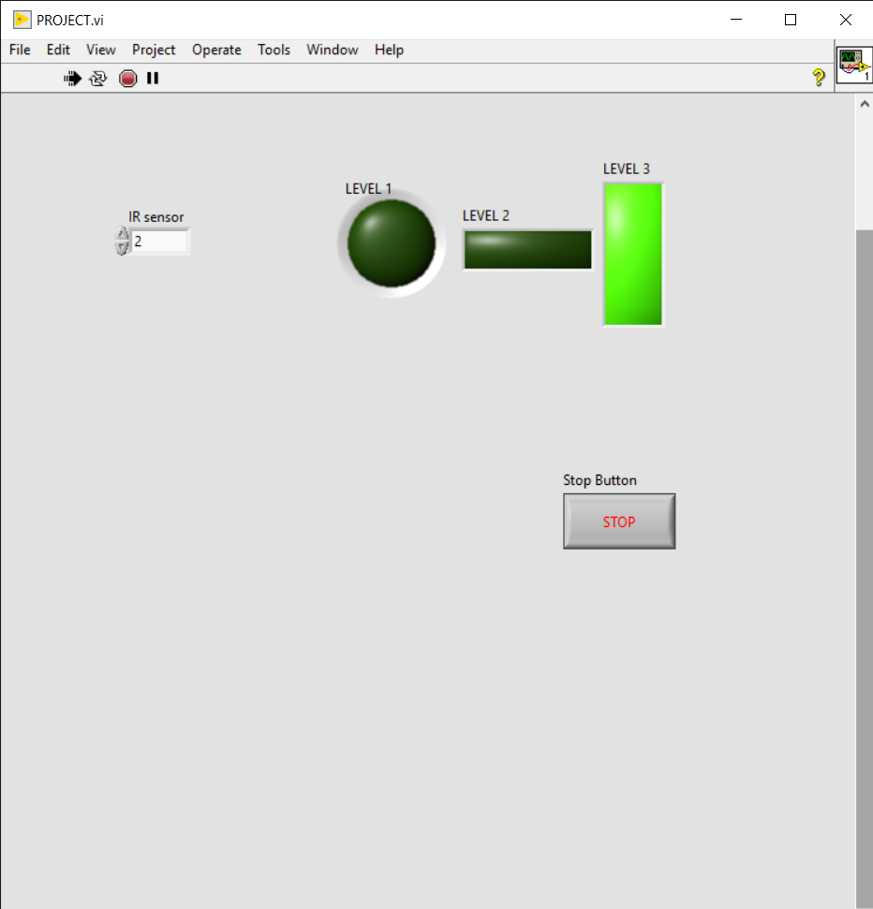
LEVEL 3:
Else if , a person whose height is in a range of about (0-2 )feet the horizontally mounted rectangular shape starts glowing.

Slide 10
CONCLUSION:
Thus, the kitchen sink is made adjustable now and so the user feels comfortable in the process of dishwashing, and the objective of our project is successfully completed.

